Slide 1
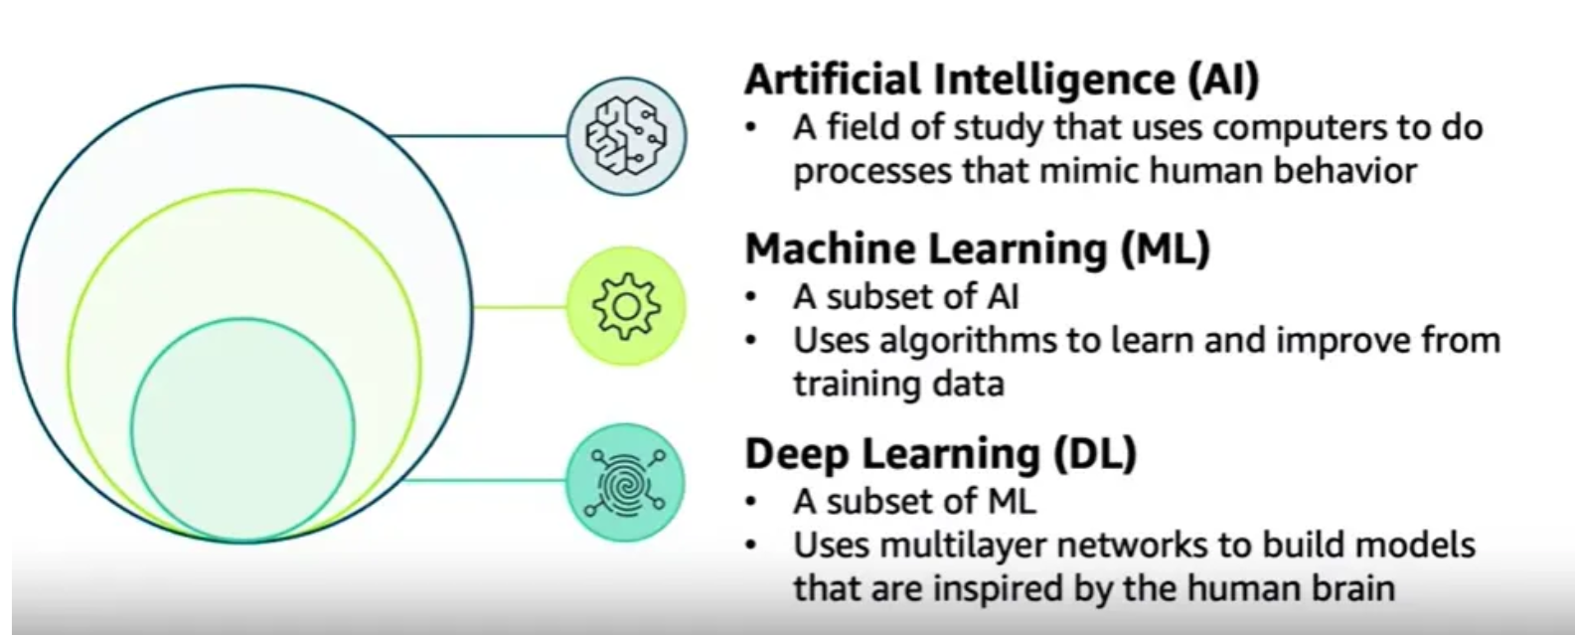

Slide 2
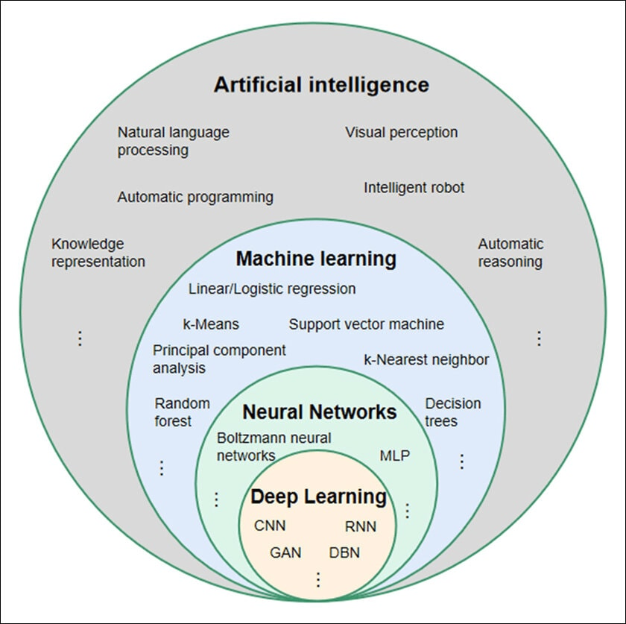

Slide 3
What Is Artificial Intelligence?
What Is Machine Learning?
What is Deep Learning?
What are Neural Networks?
Difference between AI,ML,DL

Slide 4
Deep Neural Networks (DNNs) are advanced artificial neural networks that contain multiple hidden layers between the input and output layers.
These layers enable the network to learn hierarchical representations of data, making DNNs highly effective for solving complex problems.
Unlike traditional machine learning algorithms, deep neural networks automatically extract meaningful features from raw data.
DNNs are extensively used in real-world applications such as voice assistants, autonomous vehicles, medical diagnosis, and recommendation systems.
With the rapid growth of artificial intelligence and availability of large datasets, deep neural networks have become a fundamental component of intelligent systems.

Slide 5
Module 1 :
GENERATIVE ADVERSARIAL NETWORKS (GANS): Generative models, Concept and principles of GANs, Architecture of GANs (generator and discriminator networks), Comparison between discriminative and generative models, Applications of GANs

Slide 6
Generative modelling is a machine learning approach where a computer learns patterns from existing data and then creates new data that looks similar to the original data.
A generative model is a machine learning model designed to create new data that is similar to its training data.
Generative artificial intelligence (AI) models learn the patterns and distributions of the training data, then apply those understandings to generate novel content in response to new input data.

Slide 7
How do generative models differ from traditional machine learning models?
Traditional machine learning models are typically trained to perform specific tasks like classification or regression.
They take input data and produce a specific output, like a category label.
Generative models, on the other hand, are trained to understand the underlying distribution of the data and can generate new data samples that resemble the training data.

Slide 8
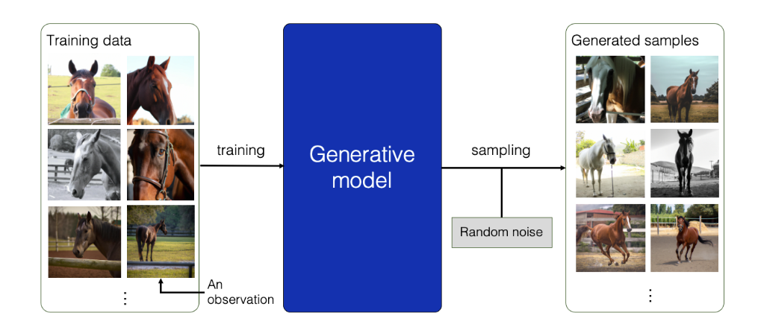

Slide 9
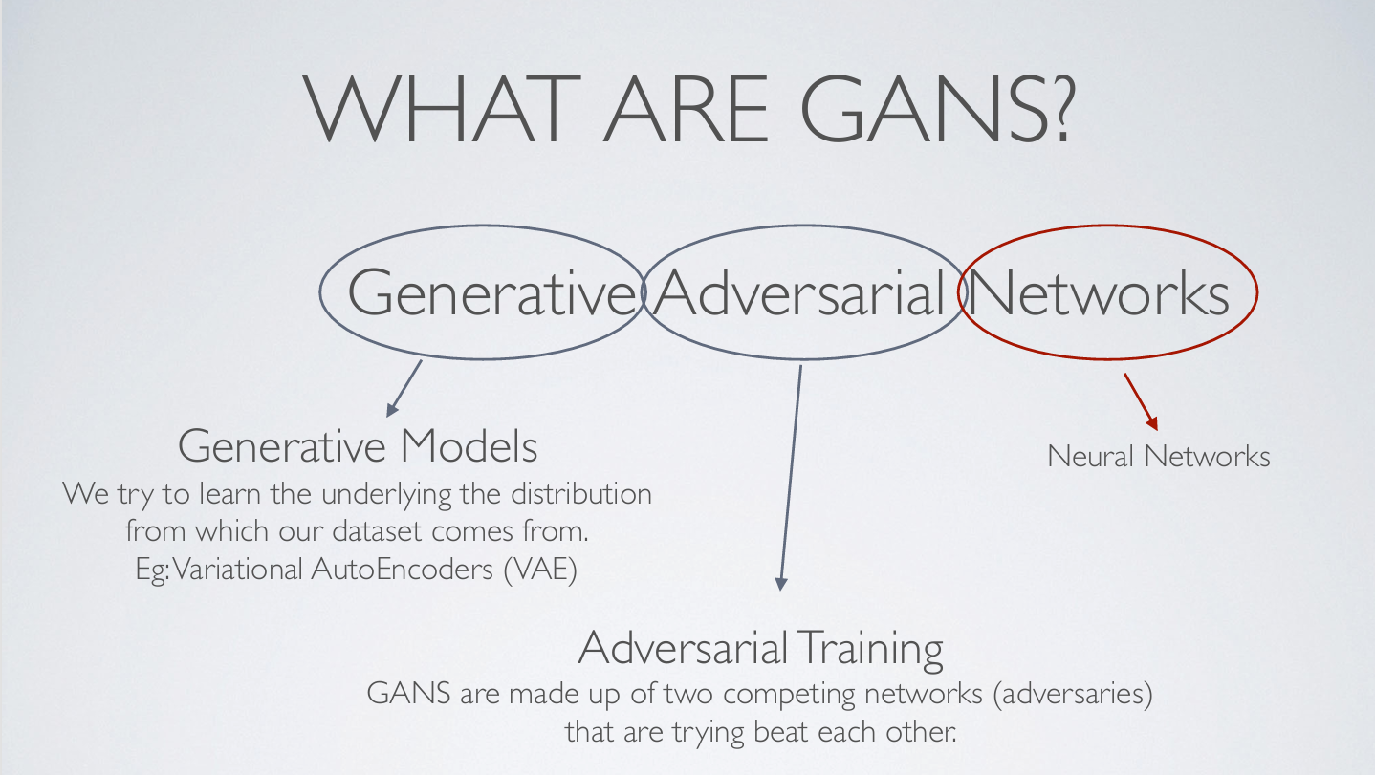

Slide 10
Why Generative Adversarial Networks(GANs)?
If your training data is insufficient, no problem. GANs can learn about your data and generate synthetic images that augment your dataset.
Can create images that look like photographs of human faces, even though the faces don’t belong to any real person from the given distribution. Isn’t that incredible?
Generate images from descriptions (text-to-image synthesis).
Improve the resolution of a video that captures finer details (low-resolution to high-resolution).
Even in the audio domain, GANs can be used to produce synthetic, high-fidelity audio or perform voice translations.
This is not all. GANs can do more. No wonder they are so powerful and in demand today!

Slide 11
In 2014, Ian Goodfellow and his team introduced Generative Adversarial Networks (GANs), a breakthrough in artificial intelligence (AI) that transformed how machines generate synthetic data.
By pitting two neural networks against each other, GANs unlocked unprecedented capabilities in creating realistic images, videos, and datasets, paving the way for innovations across industries.
Unlike traditional models that only recognize or classify data, they take a creative way by generating entirely new content that closely resembles real-world data.
This ability helped various fields such as art, gaming, healthcare and data science

Slide 12
GANs are a class of AI models consisting of two competing neural networks:
Generator: Creates synthetic data (e.g., images, text) from random noise.
Discriminator: Evaluates whether data is real or generated.
The two networks engage in a zero-sum game, where the generator improves its outputs to fool the discriminator, while the discriminator becomes better at detecting fakes.
Over time, this competition produces highly realistic synthetic data. As Ian Goodfellow described it: “The generator is like a counterfeiter, and the discriminator is like the police.”

Slide 13
The Generator Model
The generator model takes a fixed-length random vector as input and generates a sample in the domain.
The vector is drawn randomly from a Gaussian distribution, and the vector is used to seed the generative process.
After training, points in this multidimensional vector space will correspond to points in the problem domain, forming a compressed representation of the data distribution.
This vector space is referred to as a latent space, or a vector space comprised of latent variables.
Latent variables, or hidden variables, are those variables that are important for a domain but are not directly observable.

Slide 14
We often refer to latent variables, or a latent space, as a projection or compression of a data distribution. That is, a latent space provides a compression or high-level concepts of the observed raw data such as the input data distribution.
In the case of GANs, the generator model applies meaning to points in a chosen latent space, such that new points drawn from the latent space can be provided to the generator model as input and used to generate new and different output examples.
After training, the generator model is kept and used to generate new samples.

Slide 15
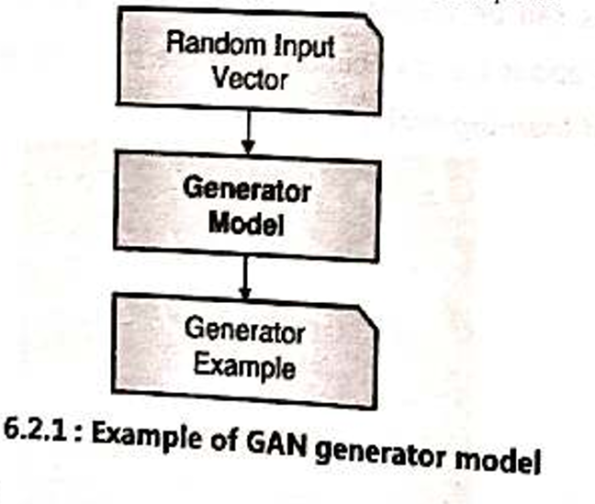

Slide 16
The Discriminator Model
The discriminator model takes an example from the domain as input (real or generated) and predicts a binary class label of real or fake (generated).
The real example comes from the training dataset.
The generated examples are output by the generator model.
The discriminator is a normal (and well understood) classification model.
After the training process, the discriminator model is discarded, as we are interested in the generator.
Sometimes, the generator can be repurposed as it has learned to effectively extract features from examples in the problem domain.
Some or all of the feature extraction layers can be used in transfer learning applications using the same or similar input data.

Slide 17
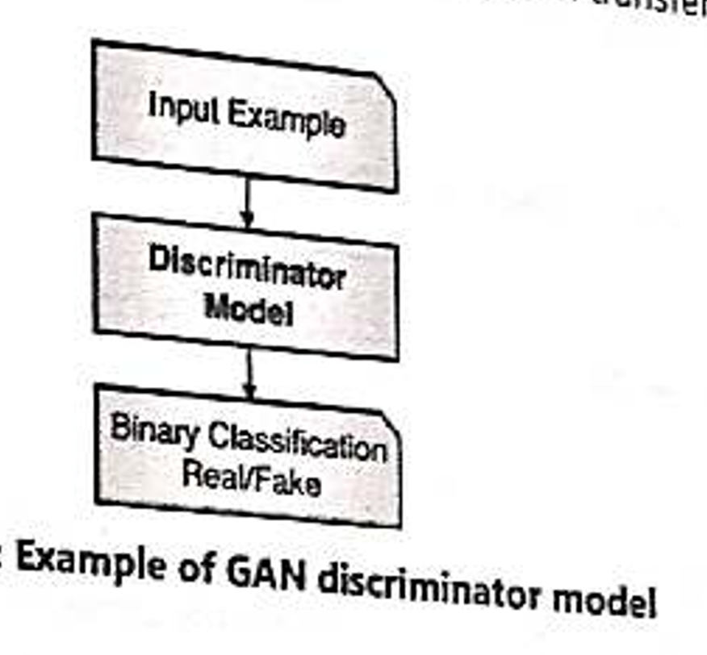

Slide 18
GANs as a Two Player Game
Generative modelling is an unsupervised learning problem,
The two models, the generator and discriminator, are trained together.
The generator generates a batch of samples and these, along with real examples from the domain, are provided to the discriminator and classified as real or fake.
The discriminator is then updated to get better at discriminating real and fake samples in the next round, and importantly, the generator is updated based on how well (or not) the generated samples fooled the discriminator.

Slide 19
When the discriminator successfully identifies real and fake samples, it is rewarded (or no change is needed to the model parameters), whereas the generator is penalized with large updates to its model parameters.
Alternately, when the generator fools the discriminator, it is rewarded (or no change is needed to the model parameters), but the discriminator is penalized and its model parameters are updated.
At the limit, the generator generates perfect replicas from the input domain every time, and the discriminator cannot tell the difference and predicts “unsure” (e.g., 50% real and 50% fake) in every case.

Slide 20
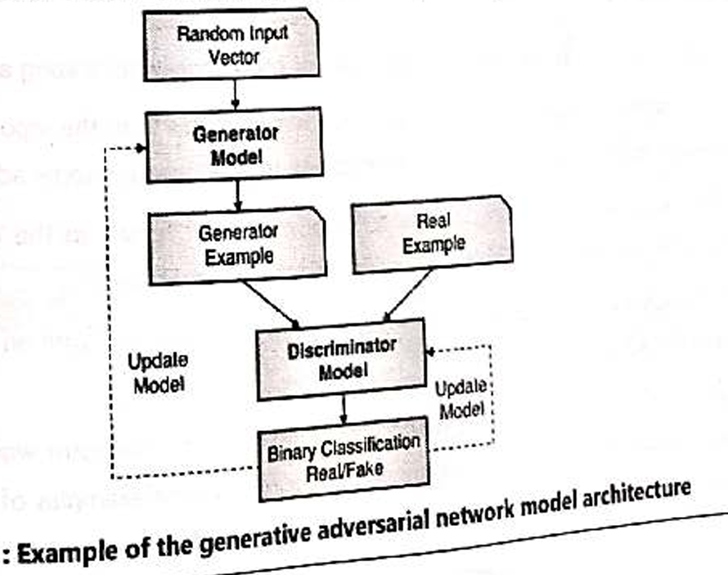

Slide 21
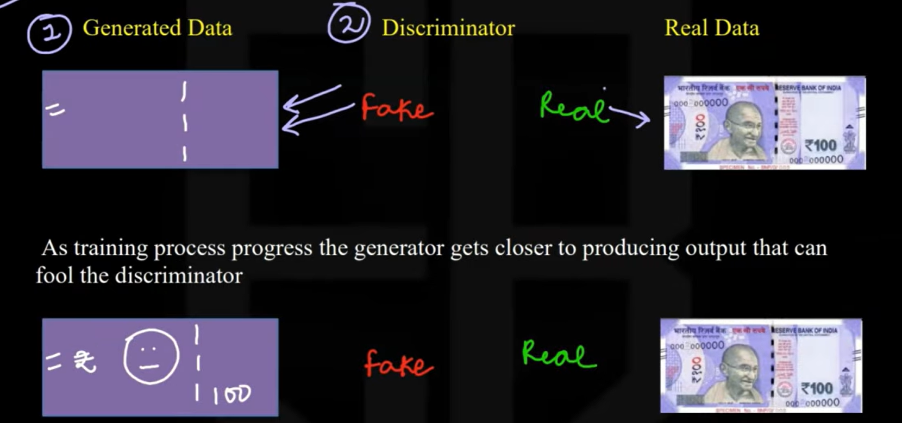

Slide 22
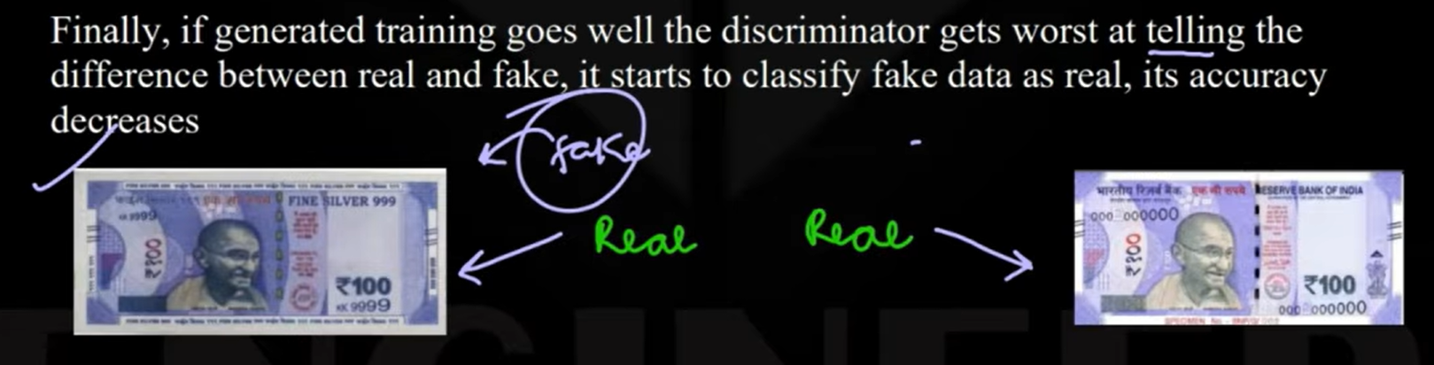

Slide 23
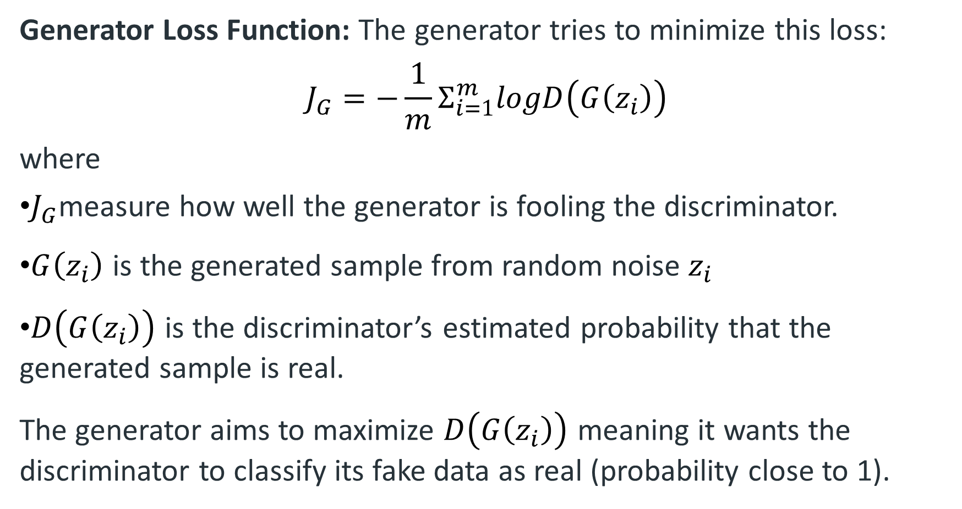
Generator Loss Function: The generator tries to minimize this loss:
$$J_{G}=−\frac{1}{m}Σ_{i=1}^{m}logD\left(G\left(z_{i}\right)\right)$$
where
$J_{G}$measure how well the generator is fooling the discriminator.
$G\left(z_{i}\right)$ is the generated sample from random noise $z_{i}$
$D\left(G\left(z_{i}\right)\right)$ is the discriminator’s estimated probability that the generated sample is real.
The generator aims to maximize $D\left(G\left(z_{i}\right)\right)$ meaning it wants the discriminator to classify its fake data as real (probability close to 1).

Slide 24
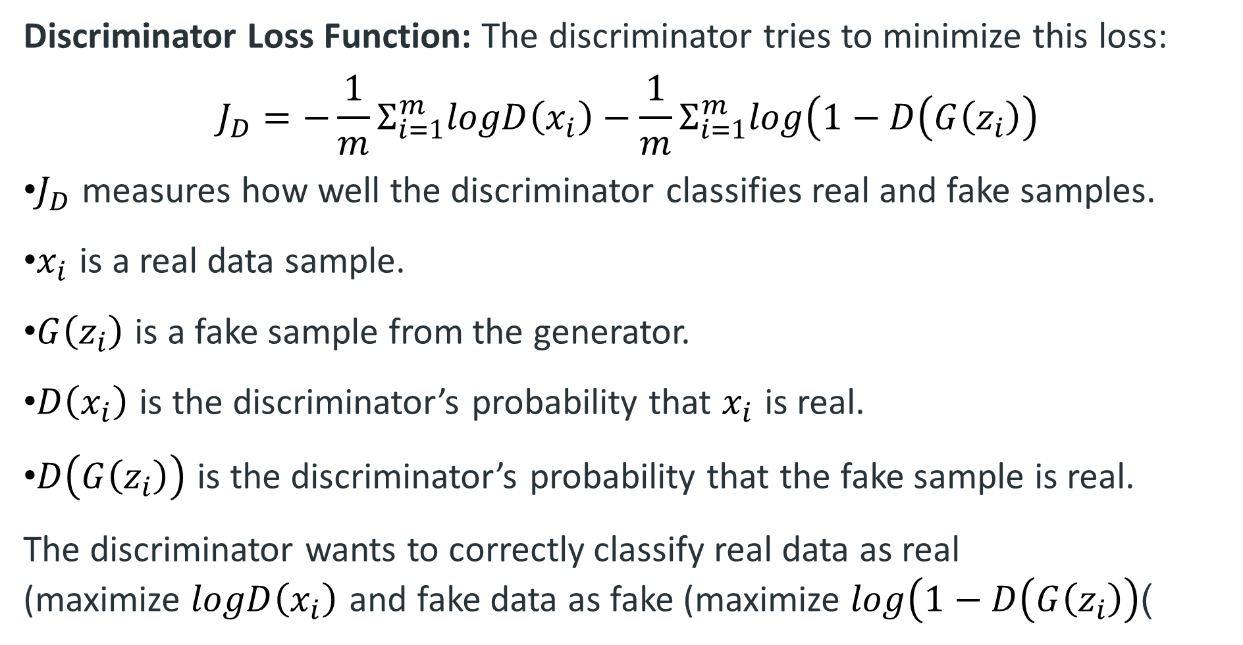
Discriminator Loss Function: The discriminator tries to minimize this loss:
$$J_{D}=−\frac{1}{m}Σ_{i=1}^{m}logD\left(x_{i}\right)−\frac{1}{m}Σ_{i=1}^{m}log\left(1−D\left(G\left(z_{i}\right)\right)\right.$$
$J_{D}$ measures how well the discriminator classifies real and fake samples.
$x_{i}$ is a real data sample.
$G\left(z_{i}\right)$ is a fake sample from the generator.
$D\left(x_{i}\right)$ is the discriminator’s probability that $x_{i}$ is real.
$D\left(G\left(z_{i}\right)\right)$ is the discriminator’s probability that the fake sample is real.
The discriminator wants to correctly classify real data as real (maximize $logD\left(x_{i}\right)$ and fake data as fake (maximize $log\left(1−D\left(G\left(z_{i}\right)\right)\right.$)

Slide 25
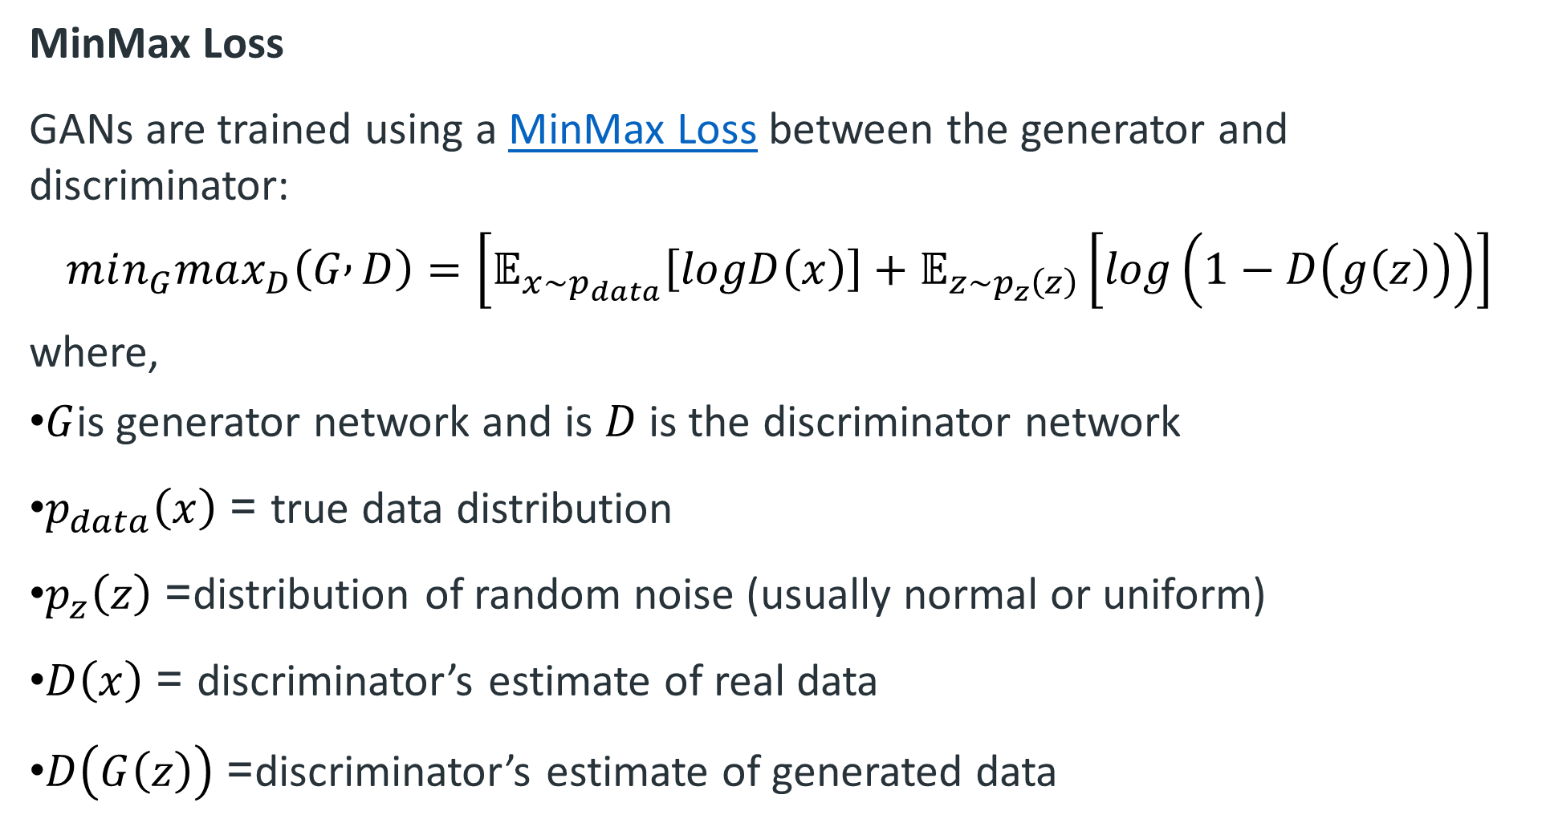
MinMax Loss
GANs are trained using a MinMax Loss between the generator and discriminator:
$$min_{G}max_{D}\left(G , D\right)=\left[𝔼_{x∼p_{data}}\left[logD\left(x\right)\right]+𝔼_{z∼p_{z}\left(z\right)}\left[log\left(1−D\left(g\left(z\right)\right)\right)\right]\right.$$
where,
$G$is generator network and is $D$ is the discriminator network
$p_{data}\left(x\right)$ = true data distribution
$p_{z}\left(z\right)$= distribution of random noise (usually normal or uniform)
$D\left(x\right)$ = discriminator’s estimate of real data
$D\left(G\left(z\right)\right)$= discriminator’s estimate of generated data

Slide 26
Types of Generative Adversarial Networks (GANs) are:
Vanilla GAN
Conditional Gan (CGAN)
Deep Convolutional GAN (DCGAN)
CycleGAN
Generative Adversarial Text to Image Synthesis

Slide 27
Vanilla GAN
This is the simplest type of GAN. Here, the Generator and the Discriminator are simple multi-layer perceptrons.
In Vanilla GAN, the algorithm is really simple; it tries to optimize the mathematical equation using stochastic gradient descent..

Slide 28
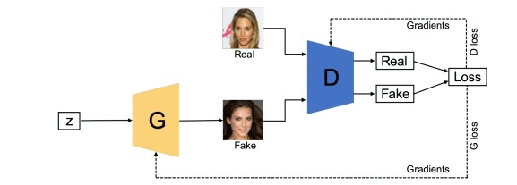

Slide 29
2. Conditional GAN (CGAN)
CGAN can be described as a deep learning method in which some conditional parameters are put into place.
In CGAN, an additional parameter ‘y’ is added to the Generator for generating the corresponding data.
Labels are also provided as input to the Discriminator so that it can help distinguish real data from fake generated data.

Slide 30
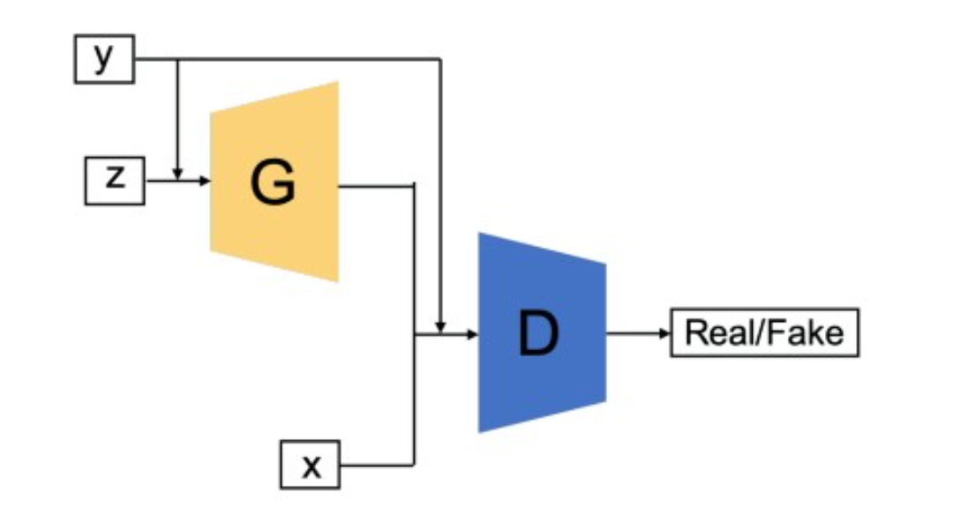

Slide 31
3. Deep Convolutional GAN (DCGAN)
DCGAN is one of the most popular and most successful implementations of GAN.
It is composed of Convolutional Neural Networks (ConvNets) instead of multi-layer perceptrons.
The ConvNets are implemented without max pooling, which is replaced by convolutional stride.
Also, the layers are not fully connected.

Slide 32
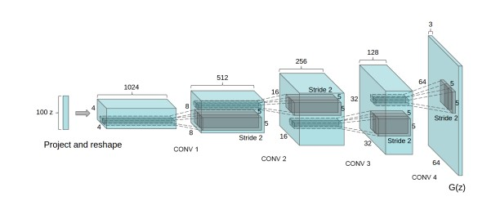
Generator of DCGAN with fractionally strided convolutional layers

Slide 33
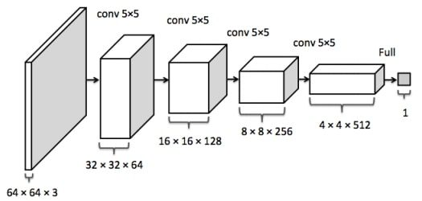
Discriminator of DCGAN with strided convolutional layers

Slide 34
4. CycleGAN -
This GAN is made for Image-to-Image translations, meaning one image to be mapped with another image.
For example , if summer and winter are made to undergo the process of Image-Image translation we find a mapping function that could convert summer images into that of winter images and vice versa by adding or removing features according to the mapping function, such that the predicted output and actual output have minimized loss.

Slide 35
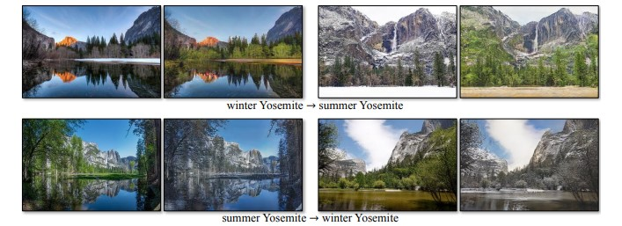

Slide 36
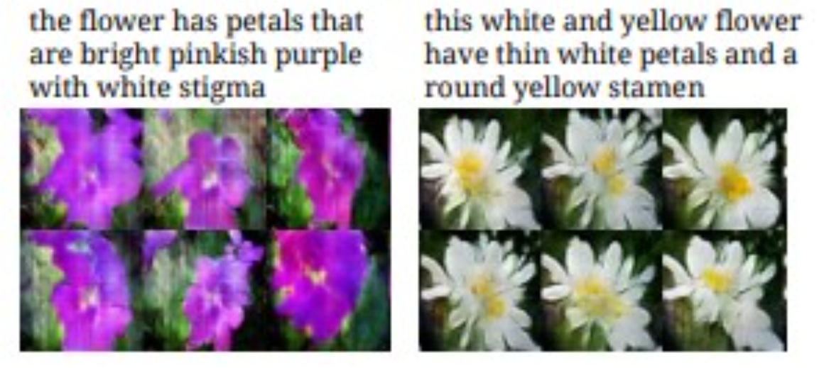
5. Generative Adversarial Text to Image Synthesis
In this the GANs are capable of finding an image from the dataset that is closest to the text description and generate similar images.

Slide 37
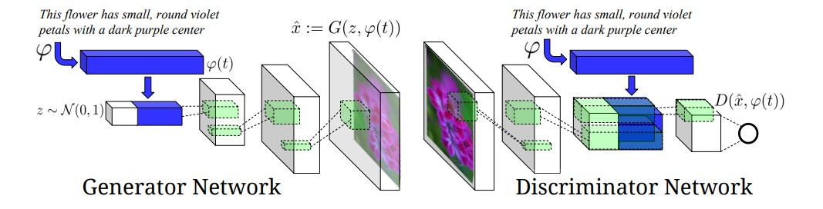
As you can the generator network is trying to generate based on the description and the diffrentiation is done by the discriminator based off the features mentioned in text description.

